Slide 1

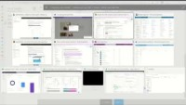
WORKFORCE OPTIMIZATION
Manage Skilling Through Viva Learning
Use Standard and Custom Learning Paths
Centralized Learning Management: Viva Learning and LMS 365 provide a centralized platform for businesses to manage their learning and development programs.
Personalized Learning Experience: Viva Learning and LMS 365 offer personalized learning experiences for employees, with customized learning paths based on their role, skills, and goals.
Increased Access to Learning Content: Viva Learning and LMS 365 enable businesses to offer a wide range of learning content, including e-learning courses, videos, podcasts, and articles, from various sources.
Viva Learning + Docs + LMS 365

